Slide 1









Deep Learning - Bonus Project
Submit by:
Itamar Babai , Dotan Danino

Slide 2

Project Description
Dataset - "IMDB Movie Reviews Dataset" that contain reviews text and a label of negative / positive review.
Goal of The project: build a model that classifies whether a given movie review is positive or negative.
we split the data 80% for train and 20% test.

Slide 3

Dummy Model
for the dummy model we build a model that completely ignores the content of the reviews and always predicts the majority class in the data
To implement we used the DummyClassifier from scikit-learn Library with strategy = most_frequent and of course train him on the train and test on the test

Slide 4

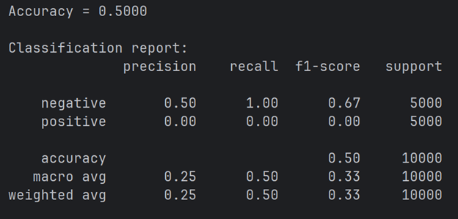

Results
The dummy model got 50% accuracy as predicted

Slide 5

Rule Based Model
This time we created 2 lists of “positive” and “negative” words and with 2 counters we checked how many “positive” words and “negative” words we have and return answer based on the majority.
In this model we tried 3 attempt of lists until we got satisfied results , of course we took lists of the same length for “positive” and “negative” words to make it equal

Slide 6
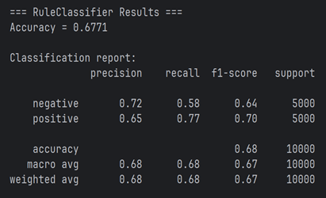
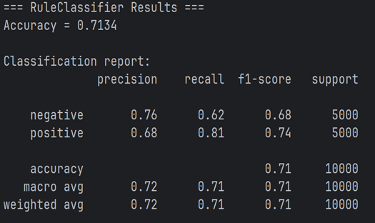
First & second attempts
First
Second
positive_words = ["good", "great", "best"
, "love", "liked","perfect", "well", "nice”, “positive"]
negative_words = ["negative", "bad", "worst",
"boring","awful", "waste","hard”, “hate"]
positive_words = ["good", "great", "best", "love", "liked", "perfect", "well", "nice", "positive", "wonderful", "excellent", "amazing", "enjoyed"]
negative_words = ["negative", "bad", "worst", "boring", "awful", "waste" ,"hard" ,"hate", "pointless" ,"terrible", "annoying", "poor", "disappointing"]

Slide 7
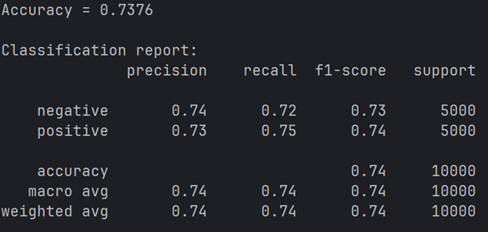
Third Attempt
In this final attempt we removed all the inculclusive words from the second attempt list and got better results

Slide 8
Logistic regression
init: We first of all used bag of words because the model can receive only numerical feature. To save memory and time we set a limit of 20,000 words in the vocabulary (we took only the most populars)
presentation: we presented each sample as numerical vector each number tell how many time each word appears in the sentence.
model: we used logistic regression and converted the labels to 1,0

Slide 9
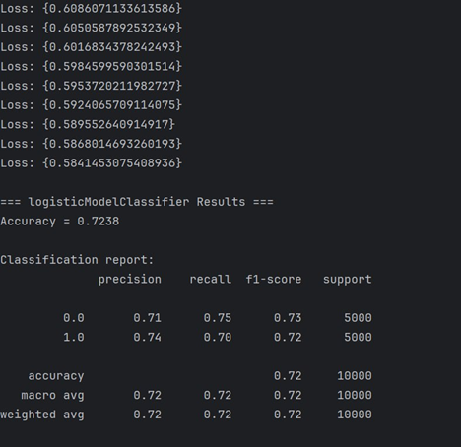
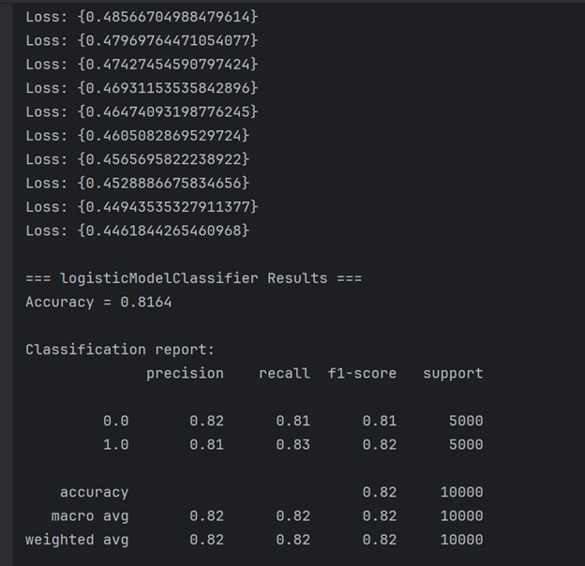
First & second attempts
First
Second
Learning rate = 0.001
num of epochs = 2000
Learning rate = 0.001
num of epochs = 20000
we can see with those parameters the model worser than the previous
huge upgrade but still not enough

Slide 10
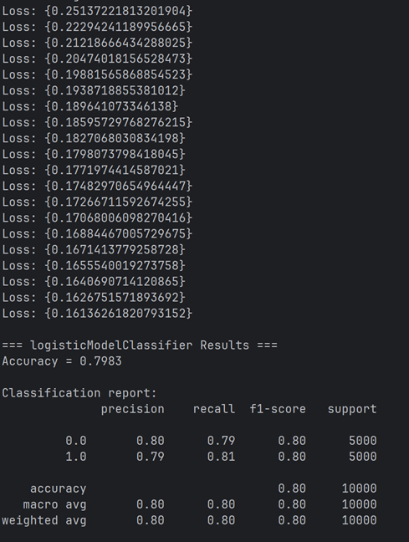
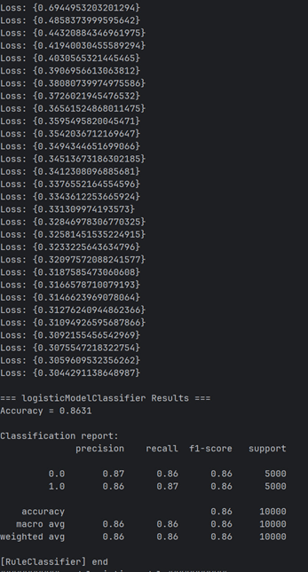
Third & fourth attempts
Third
Fourth
Learning rate = 0.001
num of epochs = 20000
Learning rate = 0.001
num of epochs = 30000
we changed to MSE but the result was worser so we stay with BCE
OUR Final Model

Slide 11
Fully connected Neural Network
init: We first of all used bag of words because the model can receive only numerical feature. To save memory and time we set a limit of 20,000 words in the vocabulary (we took only the most populars)
presentation: we presented each sample as numerical vector each number tell how many time each word appears in the sentence.
model: we used MLP model like the example from the class

Slide 12
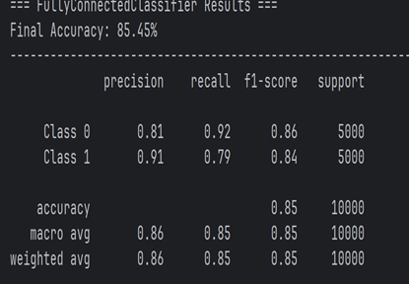
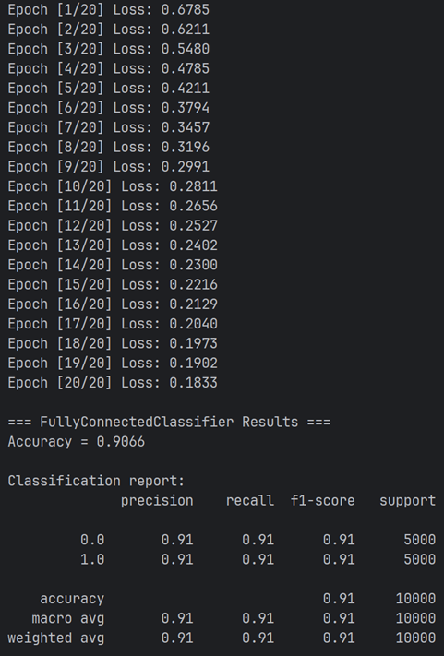
MOdels
First
Second
self.linear1 = nn.Linear(input_dim, 128)
self.linear2 = nn.Linear(128, 1)
Optimizer = SGD , Num of epoches = 10000,
self.linear1 = nn.Linear(input_dim, 128)
self.linear2 = nn.Linear(128, 32)
self.linear3 = nn.Linear(32, 1)
Optimizer = ADAM , num of epochs =20
we can see with those parameters the model worser than the previous
we can see with those parameters the model worser than the previous

Slide 13
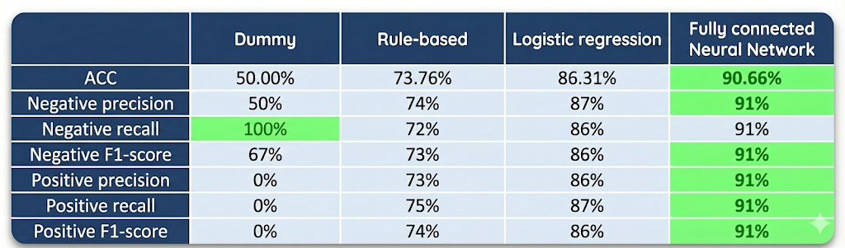
Conclusions

Slide 14
Thank you very much!

